Slide 1
Tutorial 4
By Jeremy Lim

Slide 2
Q1: Are these valid and why?
List<? super Integer> list = new List<Object>();
Not valid. Cannot create an instance of List as it is an interface

Slide 3
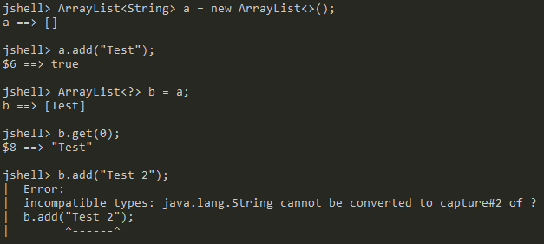
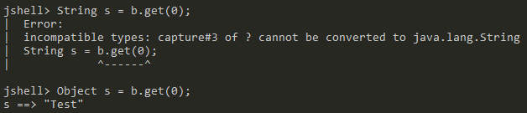
Q1: Are these valid and why?
List<?> list = new ArrayList<String>();
Valid. ArrayList implements List and <?> is bound to String.
Cannot add anything to the list
Can use List methods to get Object

Slide 4
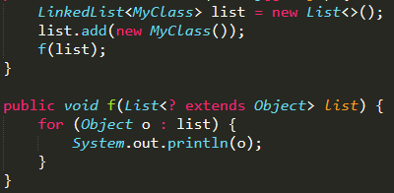
Q1: Are these valid and why?
List<? extends Object> list = new LinkedList<Object>();
Valid. <Object> upper-bounded by <? extends Object>
Producer Extends Consumer Super (PECS)
list is a producer of objects
list is guaranteed to contain Objects, able to call .get() to retrieve Object

Slide 5
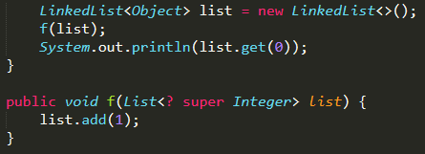
Q1: Are these valid and why?
List<? super Integer> list = new LinkedList<>();
Valid. Type specified in variable type, so type of LinkedList is inferred to be <Integer>
Producer Extends Consumer Super
list is a consumer of Integers
list is guaranteed to accept inserted Integers, able to call .add(1)

Slide 6

Q2: Which are valid, given a class A<T>?
new A<int>()
Not valid. Primitive type cannot be the generic type
new A<>()
Valid. Java creates A<Object>
new A()
Valid. Equivalent to calling new A<Object>()
Reasoning: Early versions of Java did not have generics. When generics introduced, backwards-compatible with existing code (using List, etc.)

Slide 7
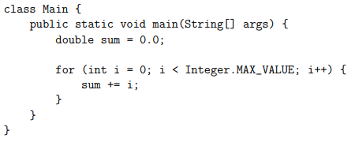
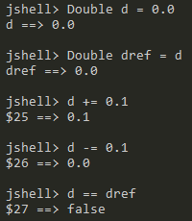
Q3
Double
vs
Measure execution time difference: (Try it yourself)
Using Double is slower because of added overhead from autoboxing
Additionally, Double is immutable: New object is created each loop
Same for all wrapper classes

Slide 8
Q4: Object Caching of Integer
Integer x = 1;
Integer y = 1;
System.out.println(x == y); // true
x = 1000;
y = 1000;
System.out.println(x == y); // false
Java caches Integer objects between -128 and 127 since they are frequently used by autoboxing and other uses

Slide 9
Q5: Compile, Run, Explain
import java.util.List;
class A {
void foo(List<Integer> integerList) {}
void foo(List<String> StringList) {}
}
Compile error. List<Integer> and List<String> considered same type by Java, still passing in a list
Type erasure: https://stackoverflow.com/questions/1998544/method-has-the-same-erasure-as-another-method-in-type
Again, history of generics in Java

Slide 10
Q5: Compile, Run, Explain
class B<T> {
T x;
static T y;
}
Compile error. Generic cannot be referenced from static context
Imagine calling B.y: What type is it?
No such thing as B<Integer>.y

Slide 11
Q5: Compile, Run, Explain
class C<T> {
static int b = 0;
T y;
C() {
this.b++;
}
public static void main(String[] args) {
C<Integer> x = new C<>();
C<String> y = new C<>();
System.out.println(x.b);
System.out.println(y.b);
}
}
Output:
2
2
There is only 1 class C although the generic type is different.
C.b is shared among all C

Slide 12

Q6
Which of the following code fragments will compile? If so, what is printed?
List<Integer> list = new ArrayList<>();
int one = 1;
Integer two = 2;
list.add(one); (autoboxed)
list.add(two);
list.add(3); (autoboxed)
for (Integer num : list) {
System.out.println(num); (auto unboxed)
}
Prints:
1
2
3

Slide 13
Q6
Which of the following code fragments will compile? If so, what is printed?
List<Integer> list = new ArrayList<>();
int one = 1;
Integer two = 2;
list.add(one); (autoboxed)
list.add(two);
list.add(3); (autoboxed)
for (int num : list) { (auto unboxed)
System.out.println(num);
}
Prints:
1
2
3

Slide 14
Q6
Which of the following code fragments will compile? If so, what is printed?
List<Integer> list = Arrays.asList(1, 2, 3);
for (Double num : list) { (Integer cannot be converted to Double)
System.out.println(num);
}
But int can be converted to double
prog.java:8: error: incompatible types: Integer cannot be converted to Double
for (Double num : list) {
^
1 error

Slide 15
Q6
Which of the following code fragments will compile? If so, what is printed?
List<Integer> list = Arrays.asList(1, 2, 3);
for (double num : list) { (Auto unboxed and widened)
System.out.println(num);
}
Prints:
1.0
2.0
3.0

Slide 16
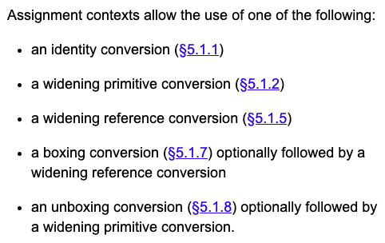
Q6
Which of the following code fragments will compile? If so, what is printed?
List<Integer> list = Arrays.asList(1, 2, 3);
for (double num : list) { (Auto unboxed and widened)
System.out.println(num);
}
Prints:
1.0
2.0
3.0

Slide 17
Q6
Which of the following code fragments will compile? If so, what is printed?
List<Integer> list = new LinkedList<>();
list.add(5);
list.add(4);
list.add(3);
list.add(2);
list.add(1);
Iterator<Integer> it = list.iterator();
while (it.hasNext()) {
System.out.println(it.next());
}
Prints:
5
4
3
2
1
Same as
for (Integer i : list) {
System.out.println(i);
}

Slide 18
Additional Reference (Casting, Boxing, Widening/Narrowing)
https://docs.oracle.com/javase/specs/jls/se7/html/jls-5.html

